Slide 1
DFA/NFA/Ɛ-NFA to RE

Slide 2
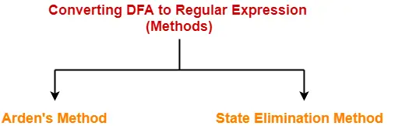
FA to Regular Expression

Slide 3
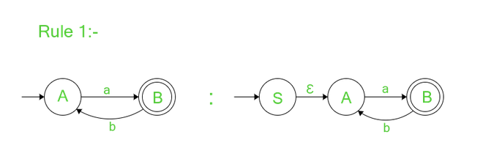
State Elimination Method convert DFA/NFA/Ɛ-NFA into Regular Expression
Rule-1 : If there are no incoming edges to the start state proceed further to check other rules. If there are incoming transitions to the initial state, to get rid of incoming edges make new start with no incoming edges and an outgoing edge to the old start state with Ɛ-transition. the initial state before is now normal state with added incoming Ɛ-transition.

Slide 4
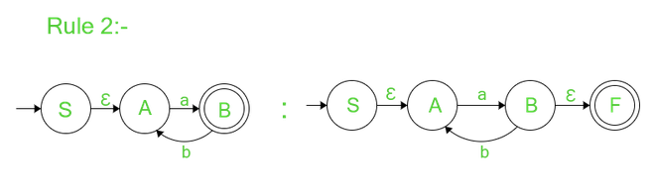
Rule-2 : If there are no outgoing edges from final state proceed further to check the last rule. If there are outgoing transitions from final state, to get rid of outgoing edges make new final state with no outgoing edges and an incoming edge from old final state of Ɛ-transition. Old final state is transformed into normal state with the added transition of Ɛ.

Slide 5
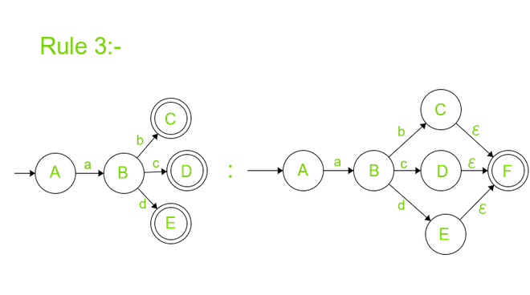
Rule-3 : If there are no multiple final states proceed to elimination (except final and initial) of normal states. If the Automata have multiple final states it is recommended to strip their status of being final states and add outgoing Ɛ-transition to new and only final state with no outgoing transitions.

Slide 6
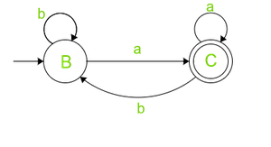
an example of DFA to find RE by State Elimination method.

Slide 7
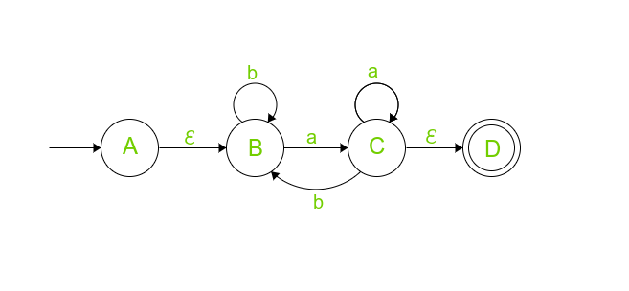
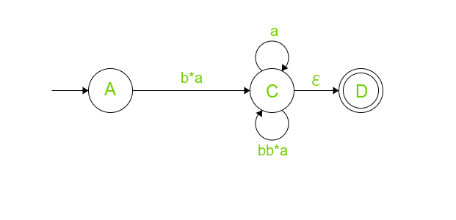
Now Rule 1, 2 is violated to satisfy them to make a new final state and new initial state with incoming Ɛ-transition and outgoing Ɛ-transition respectively.
Eliminate B and imagine if there wouldn’t have been any State B then we reach State C directly from Start state A with the input symbol of ‘Ɛb*a’=‘b*a’
Outgoing edge from State C to B is now become self Loop since State B is not there.
Edge from C is going to B, taking b* and returning to C with ‘a’ this can happen infinite time hence self-loop of b(b)*a.

Slide 8
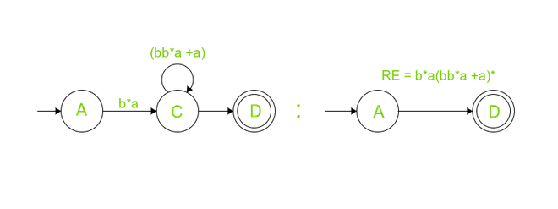
Now after eliminating C state, We would reach final State D directly from initial state A, directly from initial to final which is b*a(bb*a + a)*.

Slide 9
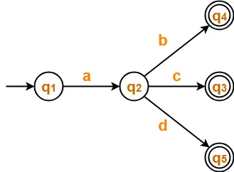
Find regular expression for the following DFA-

Slide 10
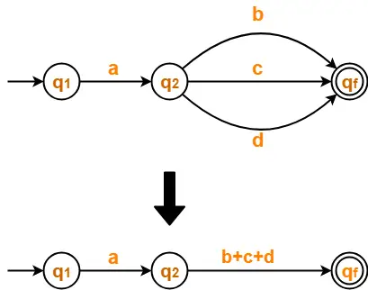
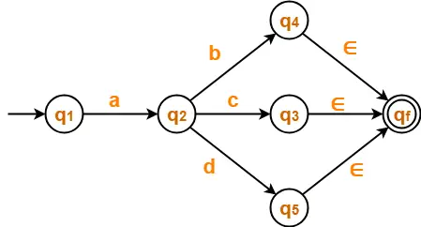

eliminate state q₃. q₄. q₅
Steps:
There exist multiple final states.
So, we convert them into a single final state.
eliminate state q₂.

Slide 11
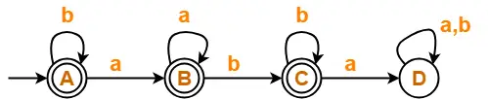

Find regular expression for the following DFA-
We know, bb* + ∈ = b*
Regular Expression = b*(aa*b*+∈)

